Slide 1
Bo (Beth) Sun, Ph.D., Associate Professor
Education:
Ph.D. in Modeling and Simulations, May 2008
Old Dominion University, Norfolk, VA
M.S. in Computer Science, May 2004
Lamar University, Beaumont, TX
B.S. in Computer Science, May 2001
Wuhan University –Wuhan, China
Academic experience:
Associate Professor, Computer Science, Rowan University, 2017-present
Associate Professor and Chair, Computer Science, Lincoln University, Lincoln University, PA, 2015-2017
Assistant Professor, Computer Science, Lincoln University, Lincoln University, PA, 2011-2015
Assistant Professor, Bioinformatics and Computer Science, University of the Sciences, Philadelphia, 2008-2011
Research Interests: Medical Simulation, Image Processing, Data Visualization, Visual Analytics.

Slide 2
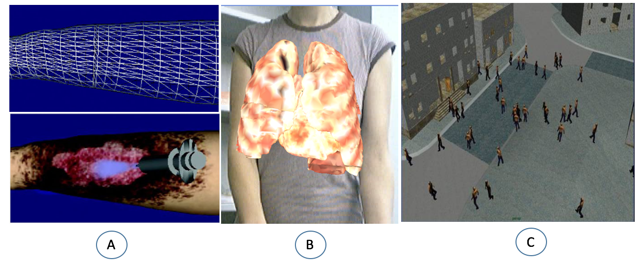
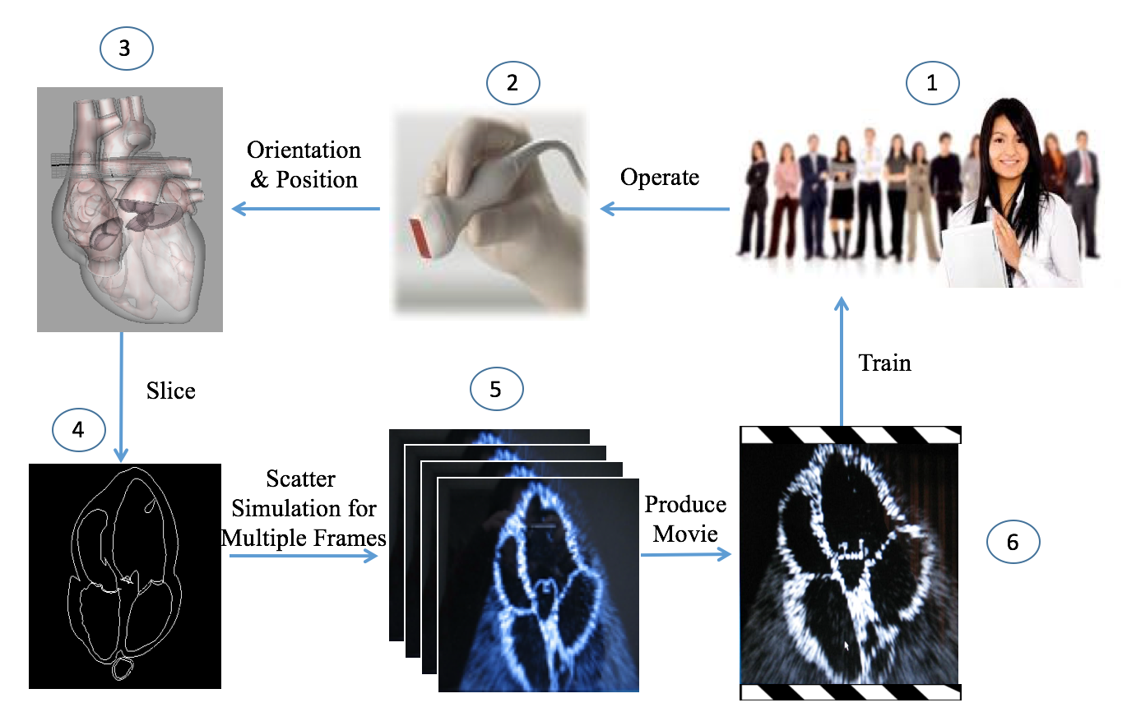
Research Experiences on Medical Simulation, Bo (Beth) Sun, Ph.D.
Developed techniques in immersive technology (VR, AR) such as simulated wound surgery with haptic device (A), virtual chest anatomy projected on manikin (B), crowd modeling using immersive and game technology (C)
Real Time Ultrasound Simulation for Medical Training and Assessment

Slide 3
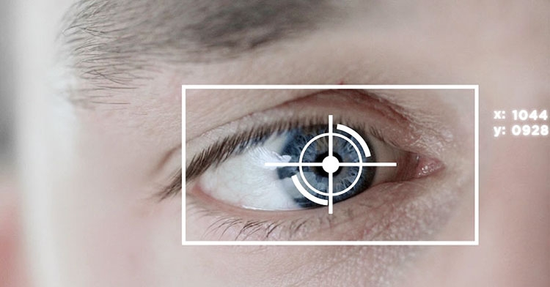
Research Experiences on Image Processing, Bo (Beth) Sun, Ph.D.
An Image Processing-based Method For Quantification Of Microvasculature
Eye Tracking for Neuroscience Study

Slide 4
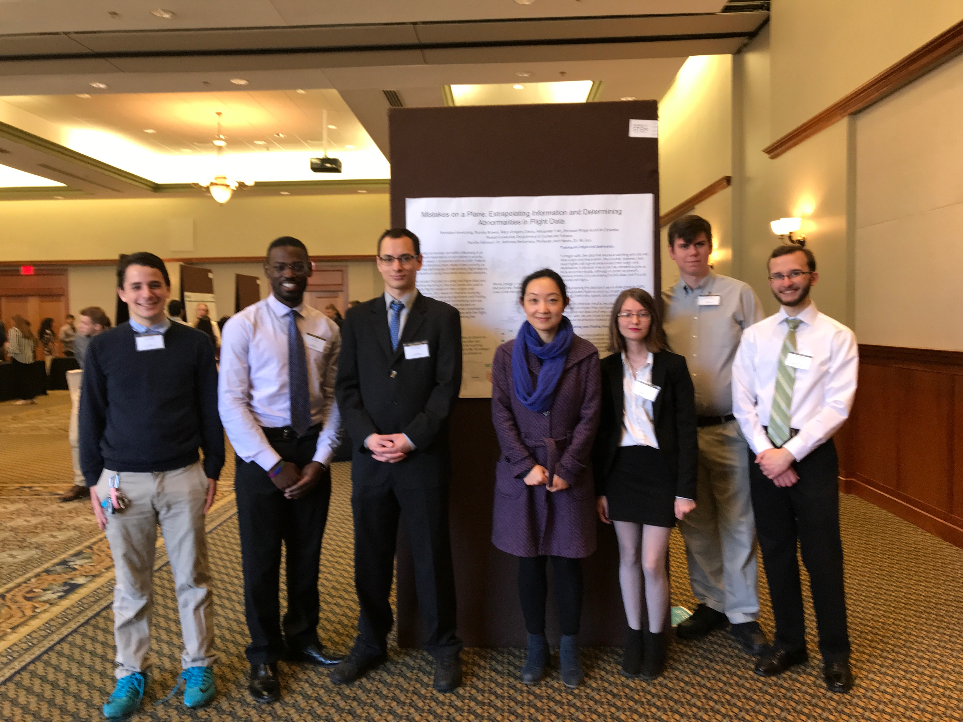
Recent Publications and Student Team, Bo (Beth) Sun, Ph.D.
Visualization Lab at Rowan
Bo Sun, Aleksandr Fritz, Wei Xu. “Immersive Visual Analysis to Explore Mystery at Wildlife Preserve”, IEEE Virtual Reality, Reutlingen, Germany, Mar. 2018.
Bo Sun, Aleksandr Fritz, Simon Su, Vincent Perry and Paul Havig. “3DUI Contest 2018: 3D Interaction”, IEEE Virtual Reality, Reutlingen, Germany, Mar. 2018.
Bo Sun, Wei Xu, Rumeel Jessamy, Soogsoo Ha. “A Tableau Case Study On Visual Analysis To Explore Mystery At Wildlife Preserve”. IEEE Visualization and Computer Graphics, IEEE VIS 2017 VAST Challenging, Phoenix, AZ, Oct. 2017.
Nicole Meister, Ziqiao Guan , Jinzhen Wang, Jiliang Liu, Julien, Lhermitte, Ronald Lashley, Bo Sun, Hong Qin, Kevin Yager And Dantong Yu. “Robust And Scalable Deep Learning For X-ray Synchrotron Image Analysis”. 2017 New York Scientific Data Summit (NYSDS): Data-driven Discovery, Aug. 2017.
Immersive Data Analytics:
Aleksandr Fritz (ECE Ph.D. student)
Benjamin Weidner (CS Sophomore)
Natural Language Animation:
Takeshwai Kamal (CS M.S. student)
Benny Liang (CS Junior)
Zay Natal (CS Freshman)
Ce Pang (CS Sophomore)
ASRC Data Analytics:
Brennan Ringel (CS Senior)
Brendan Armstrong (CS Junior)
Brooke Brown (CS junior)
Marc-Gregory Dixon (Math Senior)
Eric Zielonka (CS junior)
Aleksandr Fritz (ECE Ph.D. student)

Slide 5
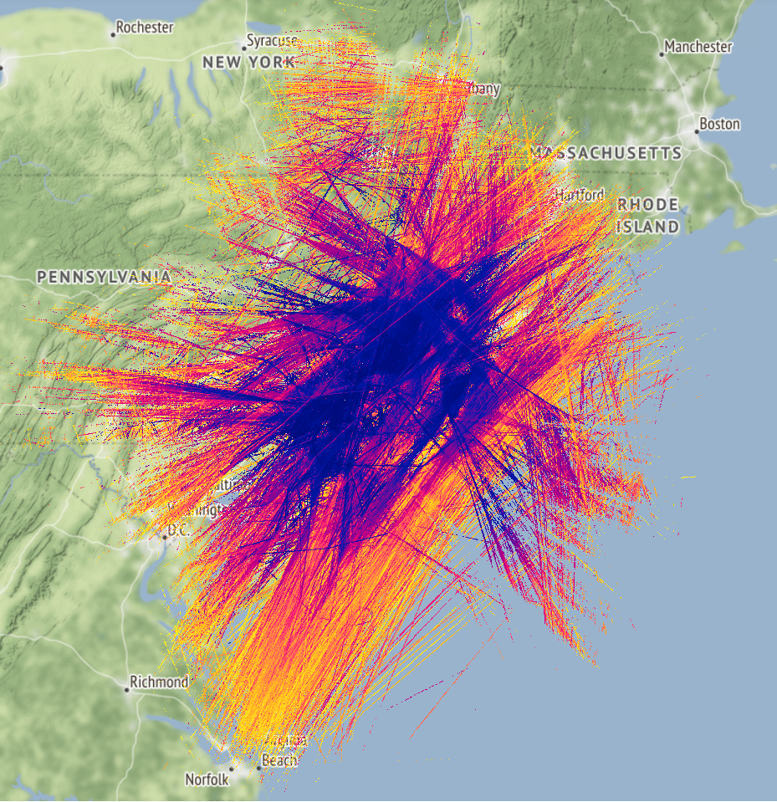
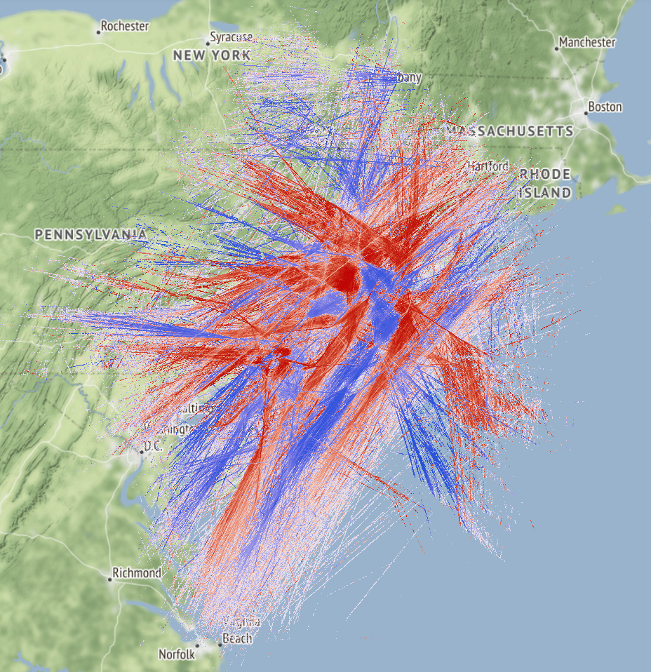
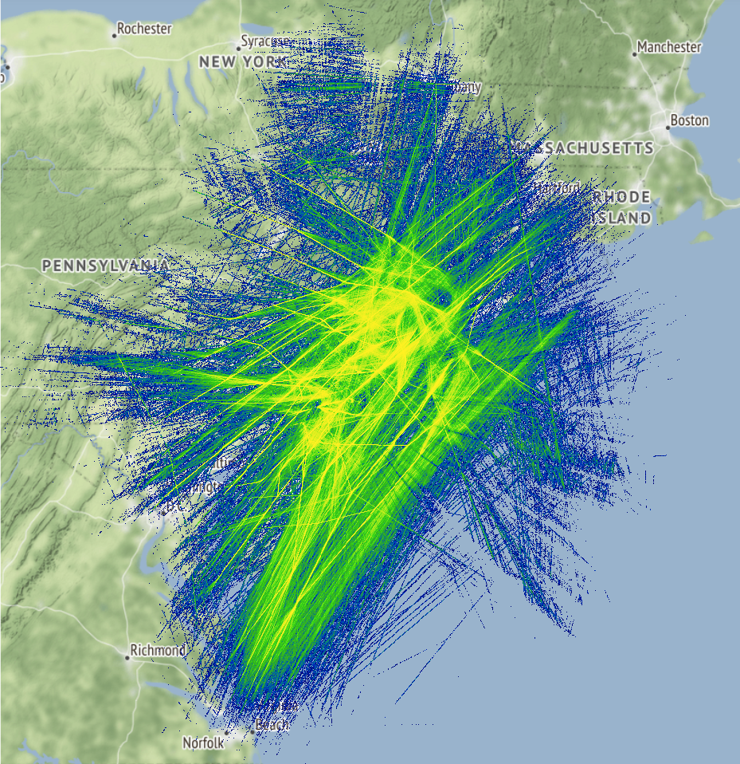
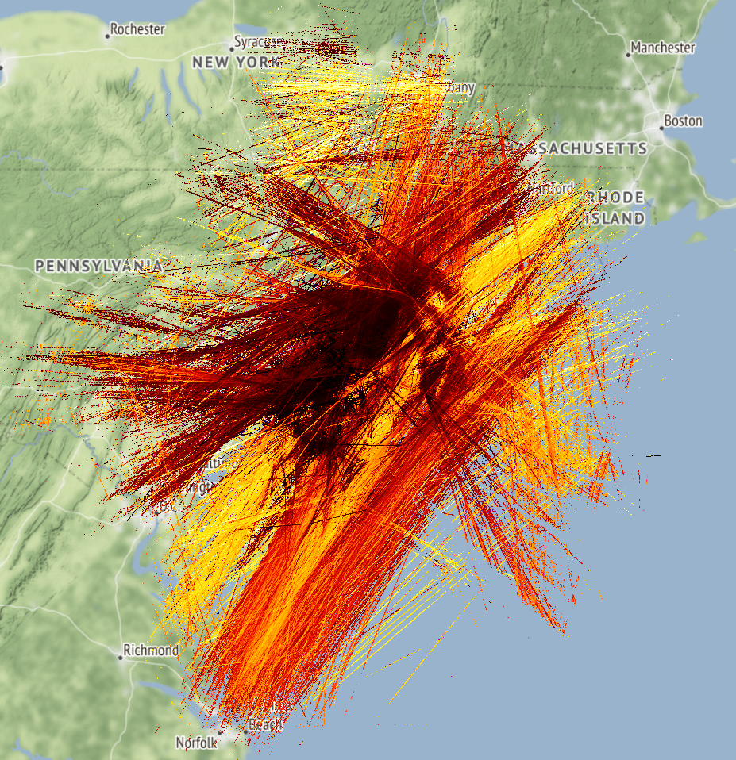
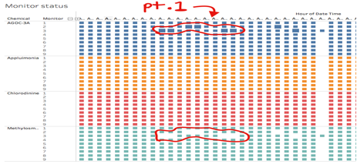
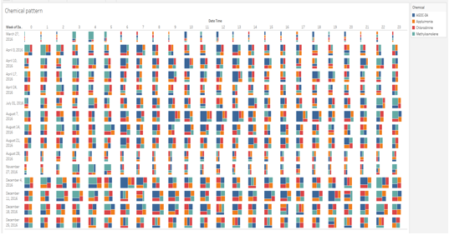
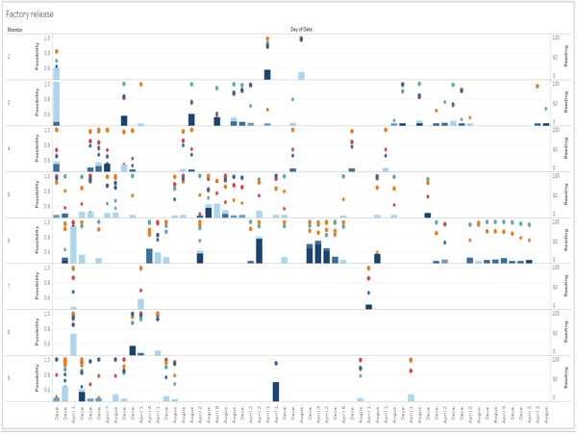
Current Project on Visual Analytics, Bo (Beth) Sun, Ph.D.
Traditional Visual Analysis on Flight Data
Traditional Visual Analysis
to Explore Mystery
at Wildlife Preserve

Slide 6

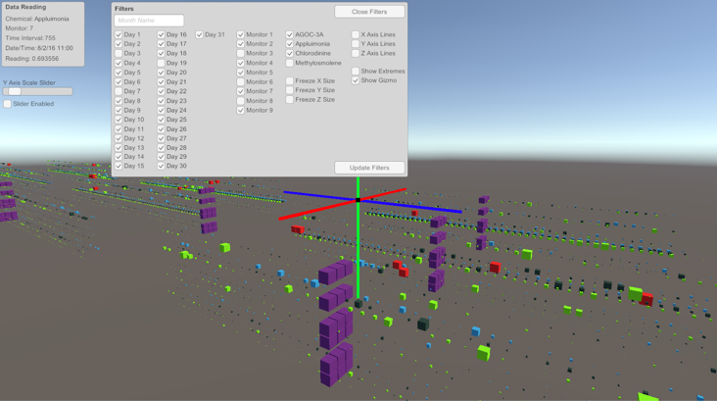
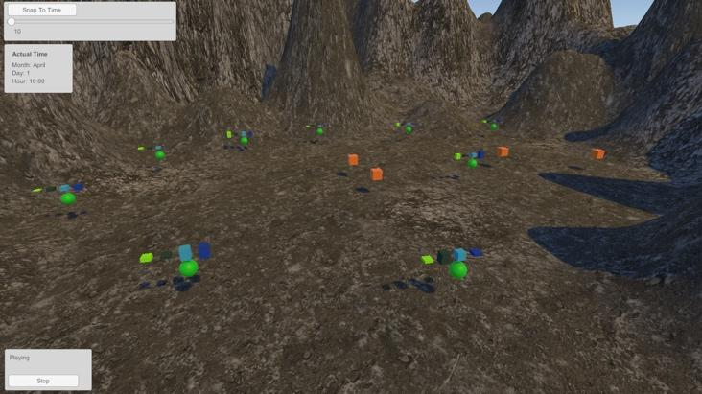
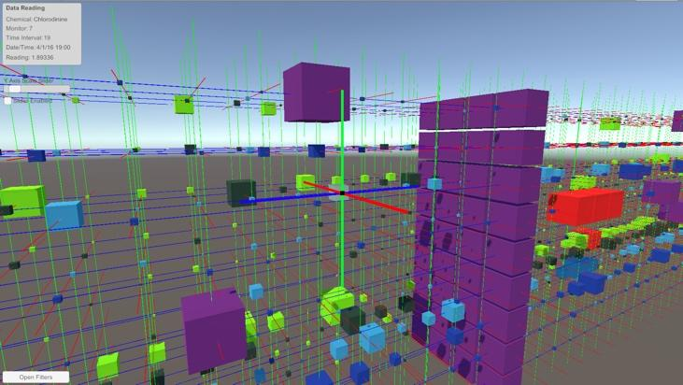
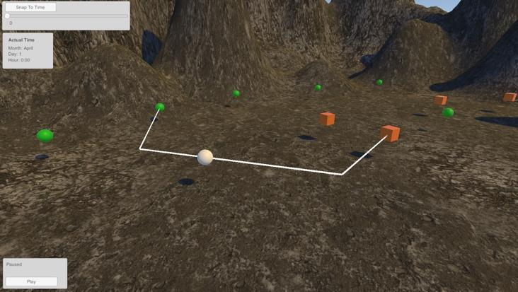
Current Project on Immersive Visual Analytics, Bo (Beth) Sun, Ph.D.
large scale and multi-dimensional datasets
Immersive Visual Analysis to Explore Mystery
at Wildlife Preserve
Aleksandr Fritz, Bo Sun, Wei Xu^{1,} Rowan University, Brookhaven National Lab¹
ID: #1318

Slide 7
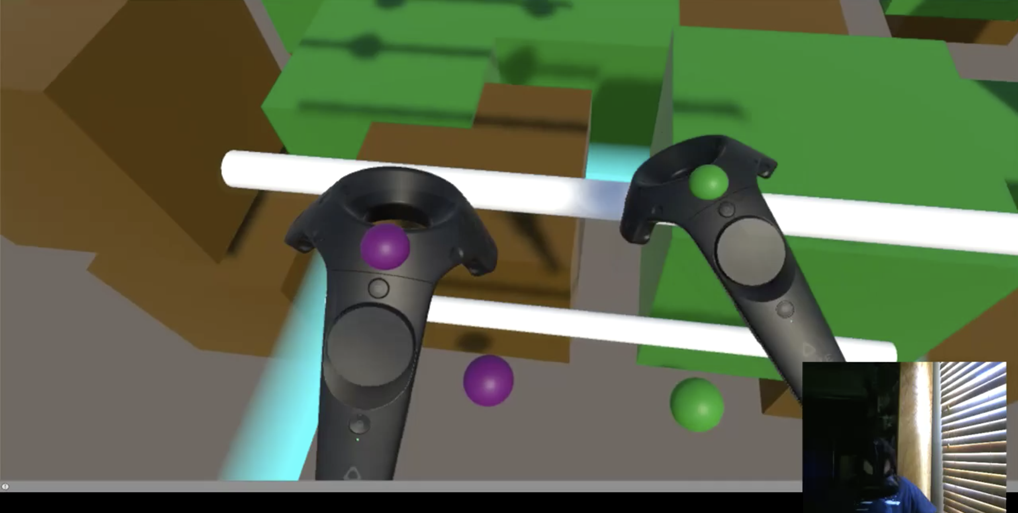
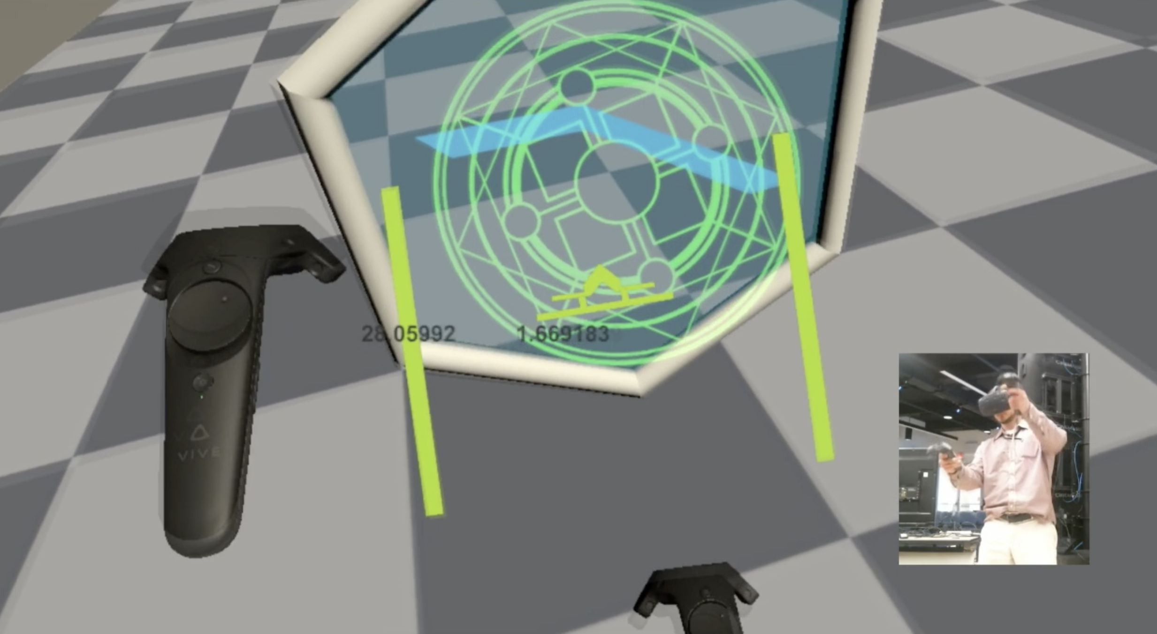
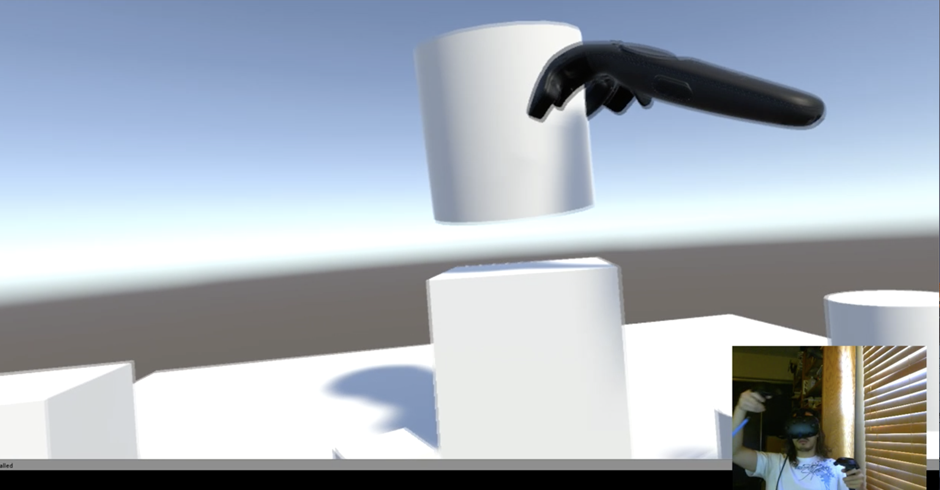
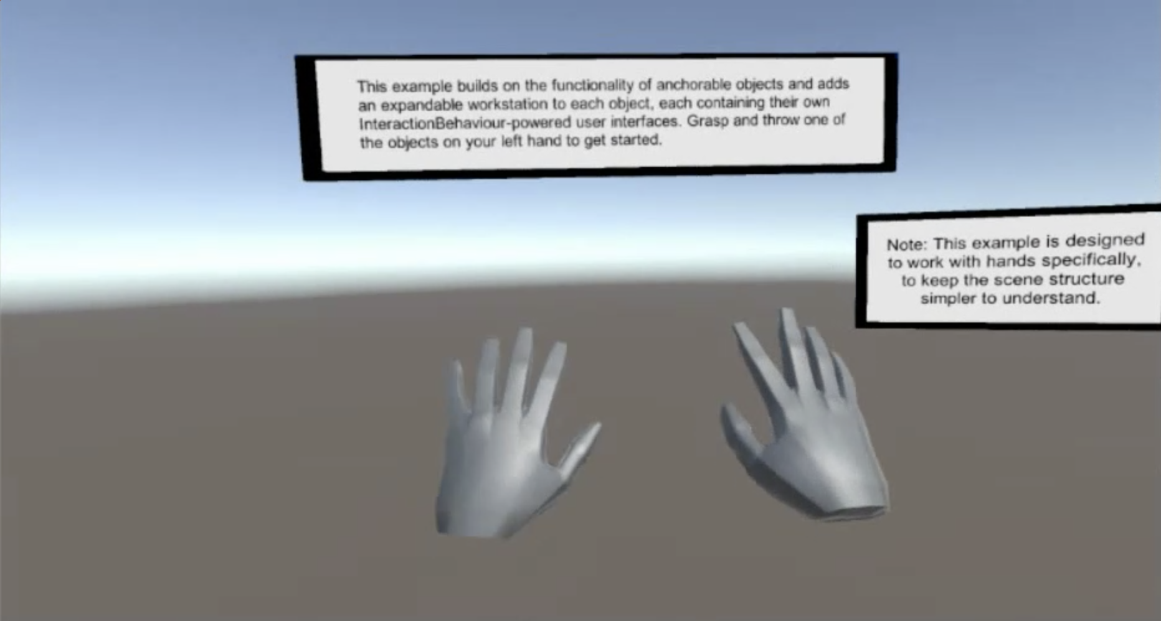
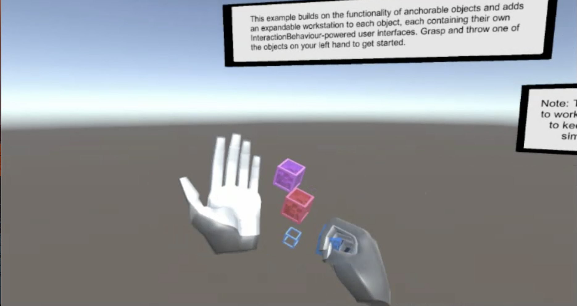
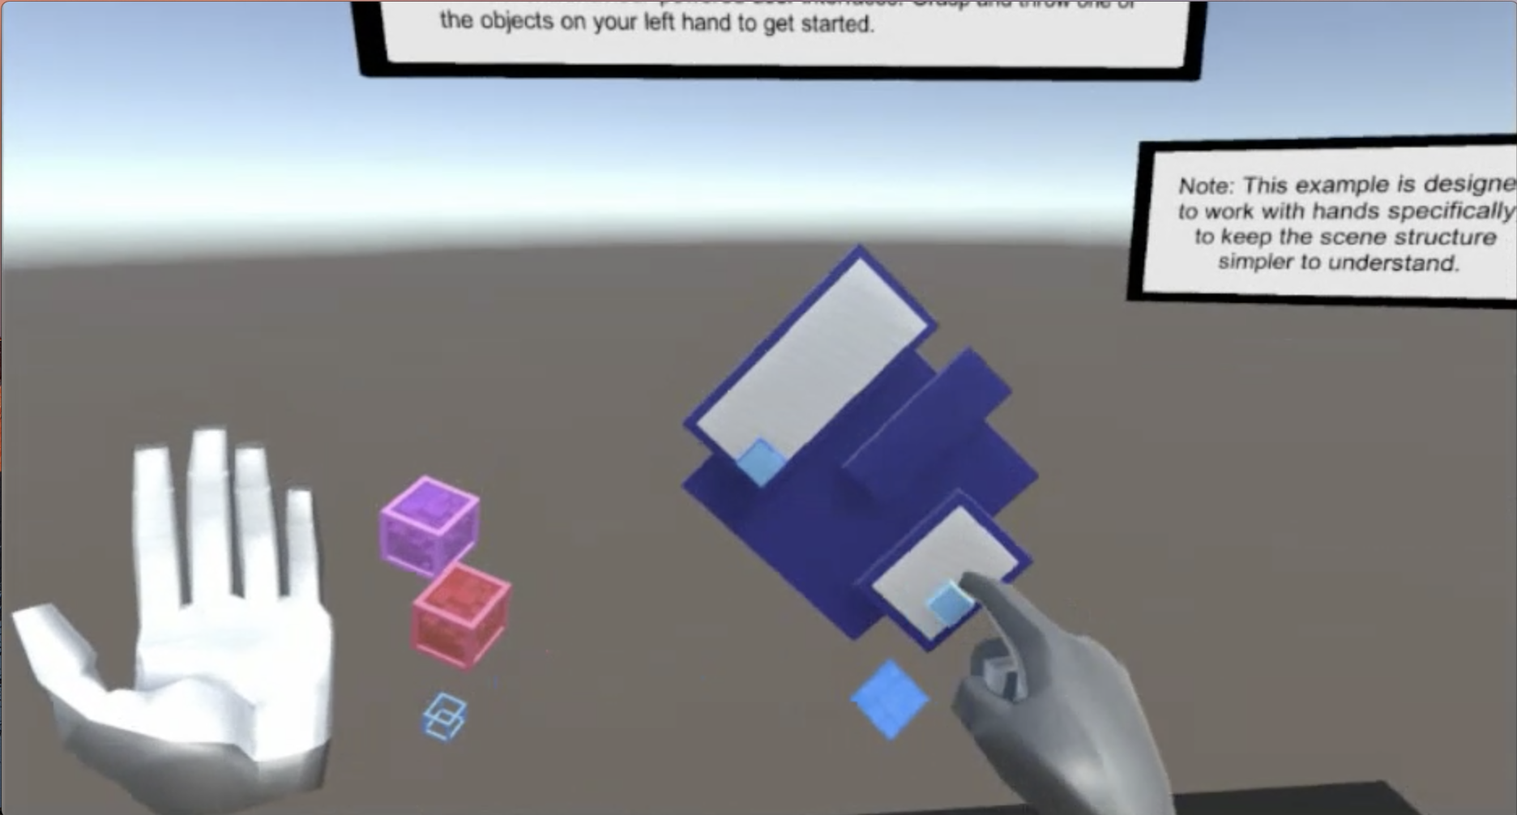
Current Project on 3DUI, Bo (Beth) Sun, Ph.D.
2018 IEEE VR 3DUI Contest
Current Research on Hand Gesture Interaction with Data Analytics

Slide 8


Slide 9
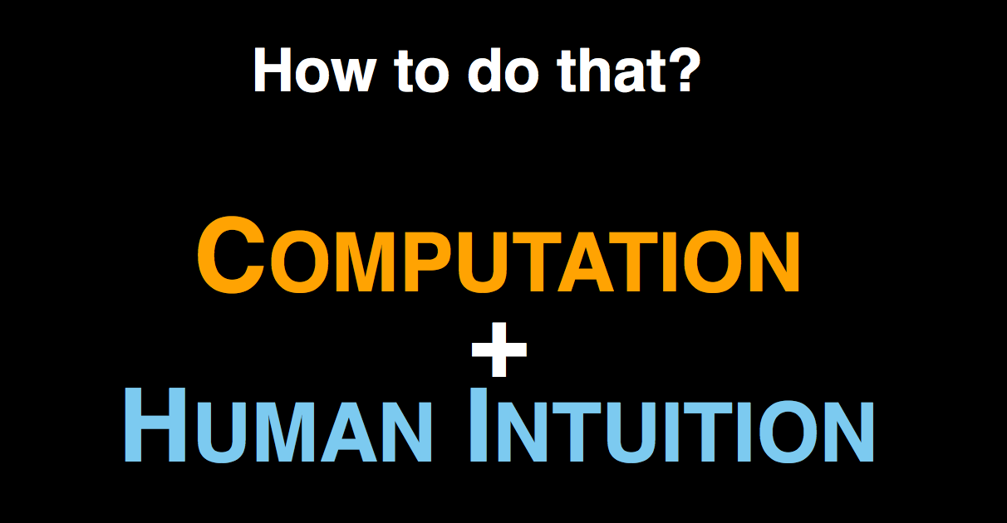

Slide 10
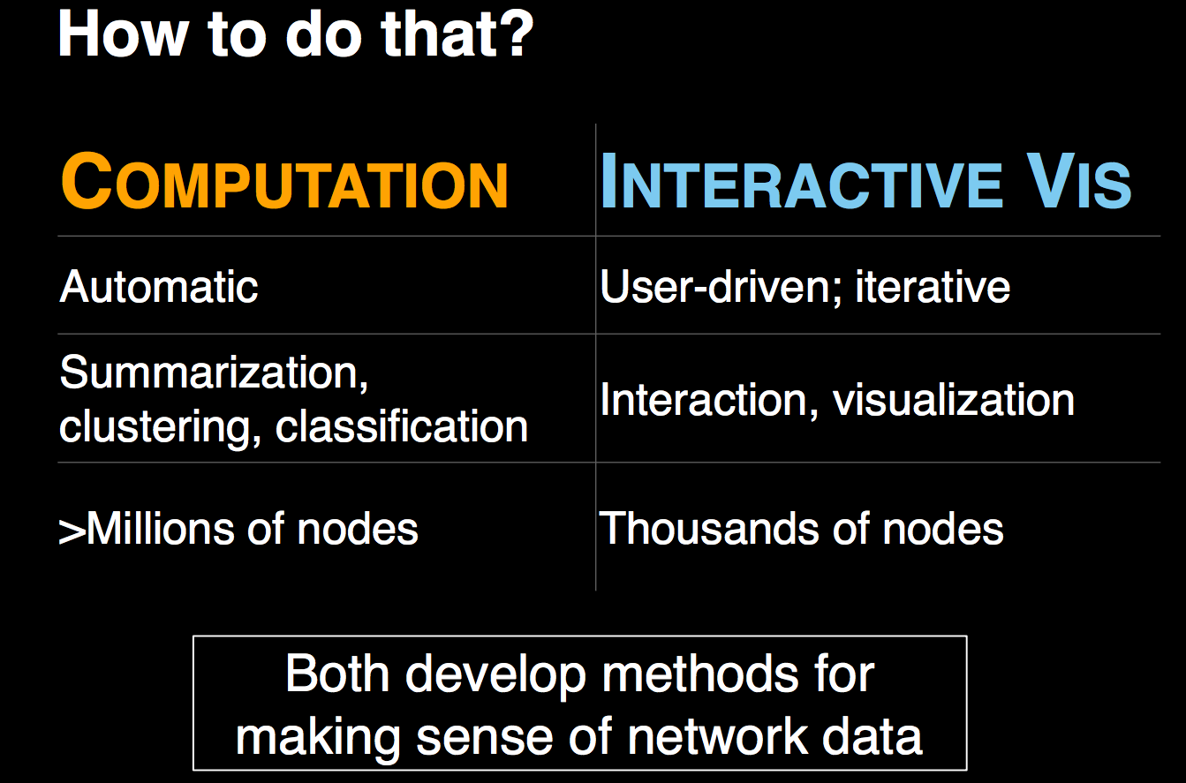

Slide 11
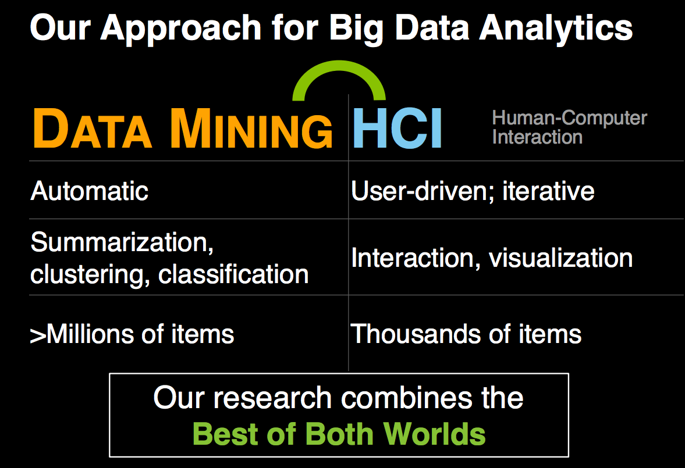

Slide 12
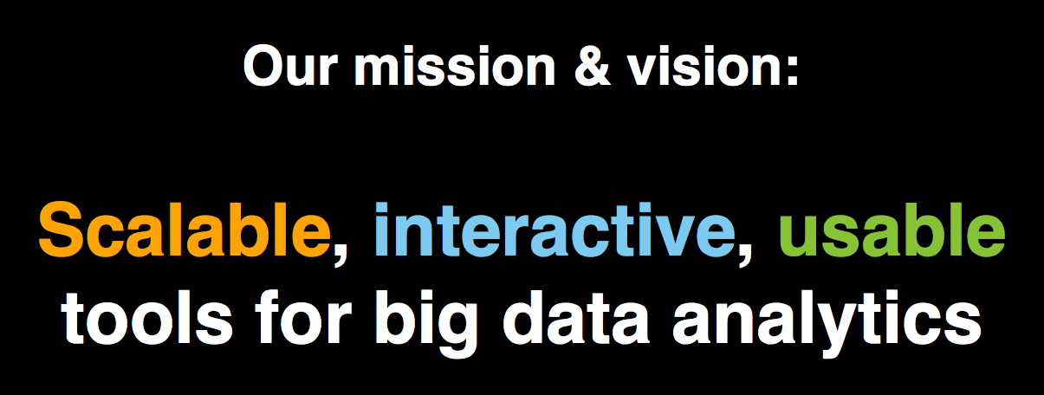

Slide 13
What is Visual Analytics?
No formal definition
Polo’s (Professor from Georgia Tech) definition: the interdisciplinary science of combining computation techniques and interactive visualization to transform and model data to aid discovery, decision making, etc.

Slide 14
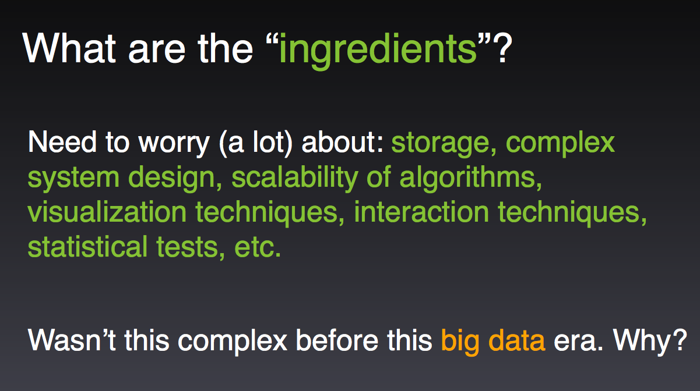

Slide 15
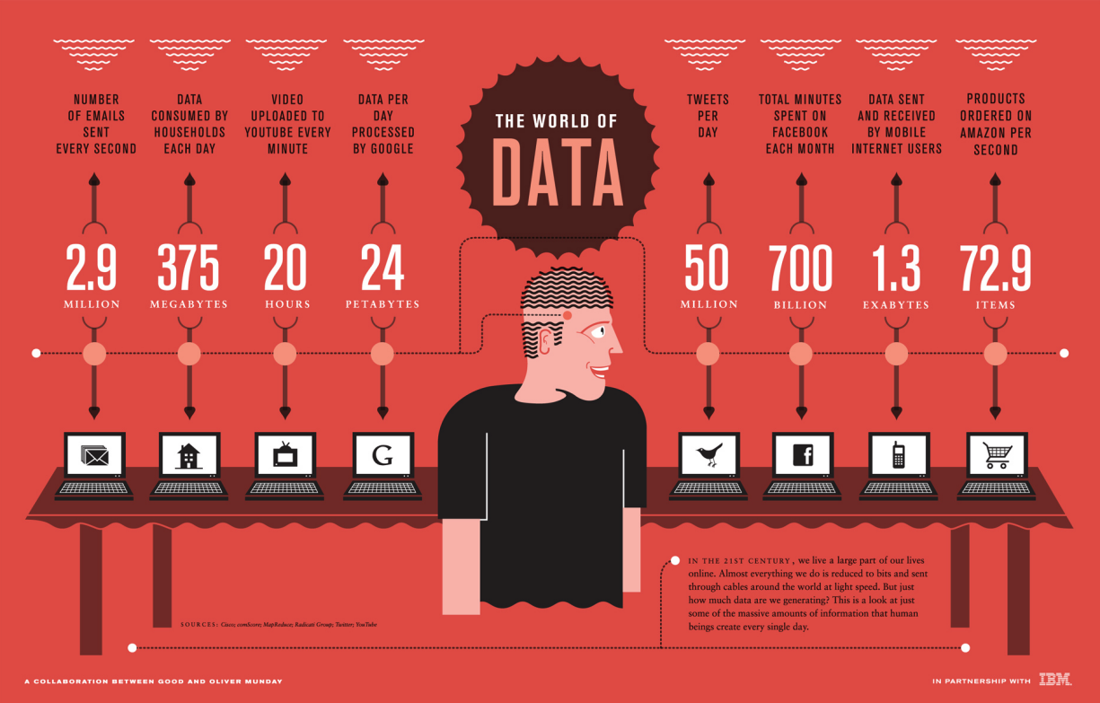

Slide 16
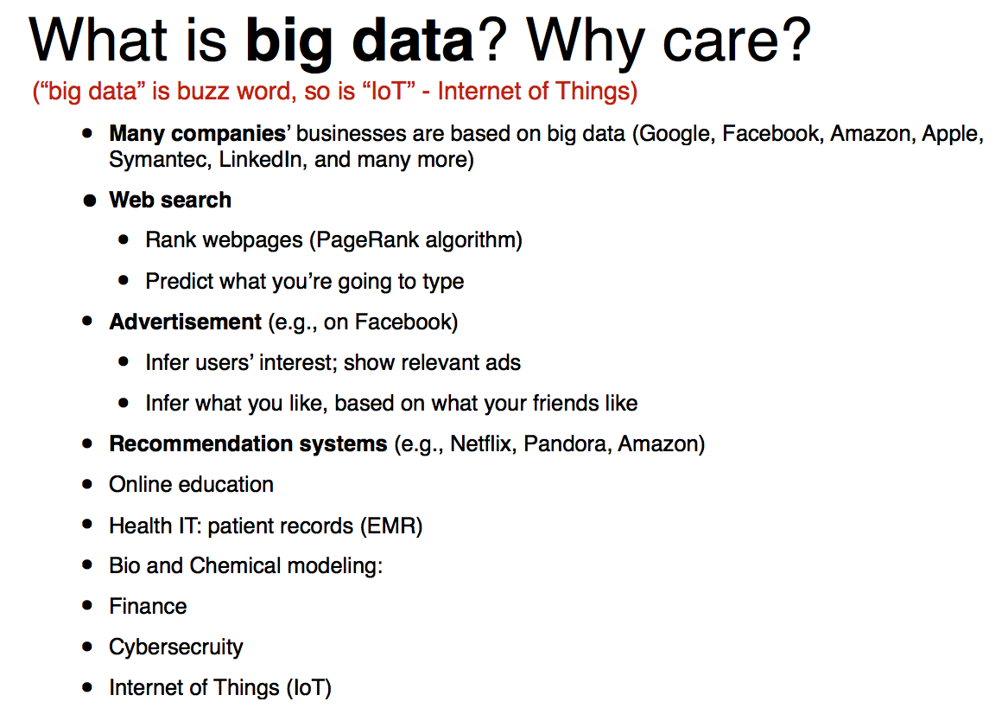

Slide 17
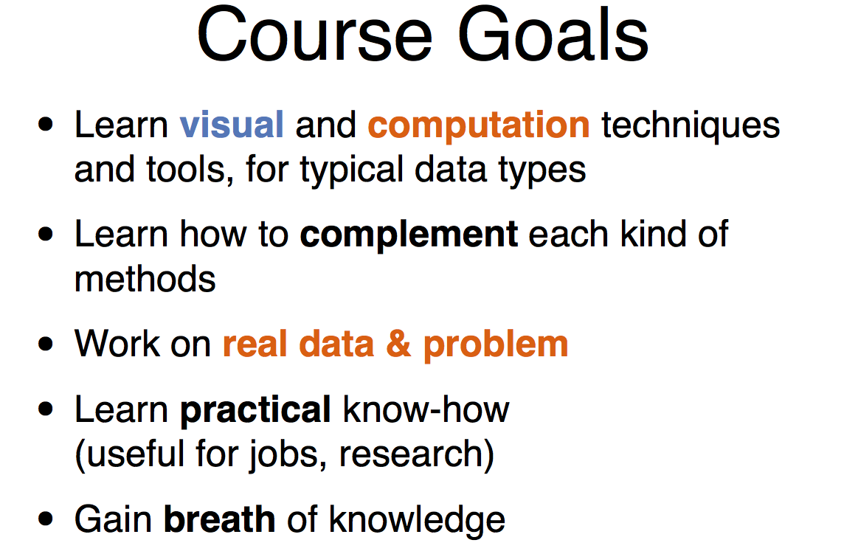

Slide 18
Require a lot of programming
Need to learn new tool and languages quickly (eg, Tableau, Python, D3, JavaScript, CSS, HTML, maybe also Hadoop, Pig, Hive )
Also see course Syllabus;
Conduct Paper presentation in Visual Analytics;
Final Project by incorporating research;
Homework (no more than 4);
No exams;

Slide 19
